Slide 1
External Libraries

Slide 2
What Are they?
A set of functions, or classes, that are wrapped up into a single file
Remember compiling code into TRANSLATION UNITS?
A library is just a bunch of those bundled together
May also be called an archive
.lib == MSVC file
.a == GCC file
Both serve the same purpose for their respective compilers
vector3.cpp
vector3.obj
math.lib
matrix.cpp
matrix.obj
quaternion.cpp
quaternion.obj
math.a
(OR – multiple .lib files packaged together as one library)

Slide 3
Why use them?
C++ has a lot of functionality, but it’s typically limited to core computational processes
File I/O, basic data types and arithmetic, etc…
The Standard Library contains a lot of useful functionality…
But it’s still “core” stuff
Data structures – vectors, maps, etc
Iterators over containers
Etc

Slide 4
Beyond core functionality
The “good stuff”
Want to load a web page? Out of luck
Draw something to screen beyond a console application? No dice
3D graphics? Audio?
C++ can’t do that by itself… but you can bet someone wrote a library to do that

Slide 5
Don’t reinvent the wheel…
Sound Library
Someone else wrote this functionality
Hooray, free code, right? RIGHT?!
Graphics Library
Math Library
Your code
Database Library
Network Library
Using an external library just gives you access to a tool – you still have to USE it

Slide 6
External code is more code for you to learn
gl<something> -- these are all part of the OpenGL graphics library, which is written in C++
New functions, new data types, new values to learn… every library has its own learning curve
glGenBuffers(1, &renderInfo.vertexBuffer);
glGenBuffers(1, &renderInfo.indexBuffer);
glGenVertexArrays(1, &renderInfo.vertexArrayObject);
// Bind vert/index settings.
glBindVertexArray(renderInfo.vertexArrayObject);
/*================== VERTEX / INDEX BUFFER ==================*/
glBindBuffer(GL_ARRAY_BUFFER, renderInfo.vertexBuffer);
glBufferData(GL_ARRAY_BUFFER, vertSize * vertexElementSize, vertData, GL_STATIC_DRAW);
glBindBuffer(GL_ELEMENT_ARRAY_BUFFER, renderInfo.indexBuffer);
glBufferData(GL_ELEMENT_ARRAY_BUFFER, indexSize * sizeof(unsigned int), indexData, GL_STATIC_DRAW);
// Data indices – 0 is position, 1 is color, 2 is tex coords
glVertexAttribPointer(0, 3, GL_FLOAT, GL_FALSE, 8 * sizeof(GLfloat), (void *)0);
glEnableVertexAttribArray(0);
glVertexAttribPointer(1, 3, GL_FLOAT, GL_FALSE, 8 * sizeof(GLfloat), (void *)(3 * sizeof(float)));
glEnableVertexAttribArray(1);
glVertexAttribPointer(2, 2, GL_FLOAT, GL_FALSE, 8 * sizeof(GLfloat), (GLvoid*)(6 * sizeof(GLfloat)));
glEnableVertexAttribArray(2);
Someone else wrote that code for you (and others) to use, but you have to learn HOW to use it
Learning how to use someone else’s library can take a considerable amount of time, depending on the size/complexity of the library

Slide 7
Importing a library
Problems:
C++ has to be built for each target platform… want a library to work on Windows? Need a build for Windows.
Want that library to work on MacOS? Need a build for MacOS.
Etc…
Sometimes the developer may provide these versions
Other times YOU may have to download source code and build the library yourself

Slide 8
Steps to take with external libraries
1. Install the thing
2. Build a project with it
3. Write code to utilize it
Steps 1 and 2 can be some of the most difficult, time-consuming, frustrating parts of a project
It can be a lot of work to prepare to do the REAL work (i.e. step 3)

Slide 9
Installation – Easy / Preferred Mode
What you want to encounter:
Download this executable
Run, wait a little bit, then it’s done automagically (maybe you have to click “Next” a few times)
What’s more likely (easy version):
Download this .zip file
Extract to some folder
Edit an environment variable to mark the location of that folder (or be sure to reference that folder when you build a project)
Linux version: install the right package, often easy as:
apt install <packageName>

Slide 10
Installation – Developer Mode
(aka why developers get paid the Big Bucks)
Figure out which version to download (Which operating system? 32 or 64-bit version? Which compiler, GCC or MSVC? Pre-compiled libraries or the source code? Etc…)
Download and extract .zip file to some location
Run some installer through a command-line interface using a Python command
Realize you don’t have Python
Install Python
Run original installation command again
Realize you didn’t install the correct version of Python
You downloaded the newest version? Well there’s your mistake right there! That’ll teach you!
(LOL, silly developer)
Life lesson:
New != Better New != Best
New == New

Slide 11
Installation – Developer Mode
(aka why developers get paid the Big Bucks)
Go back to the documentation and read which version of Python you need
Install that
Realize you can’t have the old version AND the new version installed without some issues (you can overcome this, but still… one more thing…)
Uninstall the new one
Go back to step <whatever> and resume setup of the original tool
Success! Maybe, hopefully…
Dependency: Just something your current program or library needs to function properly
A library you are trying to use may itself depend on another library, which depends on… etc
Replace Python with any other dependency (or any NUMBER of dependencies) and the rest of this still applies

Slide 12
Building a project
There could be dozens of settings…
Not something you want to manage yourself, if you can avoid it
This is where it can get really ugly…
Every library is different, and you have to sort it out yourself
Easy Mode:
Installation included a tool to create a project for an IDE, or a group of files with the necessary settings
This could be a makefile, or some program you run, and assuming Part 1 was done correctly, it “just works”
Ideally, the developers of this thing worked diligently to ensure this was the case
Open up that project, and start writing your own code!

Slide 13
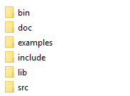
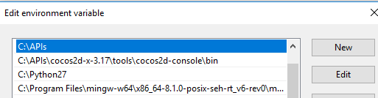
Building a project – Developer Edition
Figure out what files you need to link to (libraries, header)
Set your project to reference those files
Set your project to reference WHERE THOSE FILES LIVE
These paths can be hard-coded, or based on some environment variable
Project 1 Location: C:/Code/Projects/Proj1
C:/APIs/SomeLibrary
library_path = C:/APIs/SomeLibrary/lib
include_path = C:/APIs/SomeLibrary/include
source_path = C:/APIs/SomeLibrary/src
libraries = graphics.lib, math.lib, network.lib
The creation and usage of PATH variables depends on the OS and the program (IDE) that references them
Project 2 Location: E:/Dev/Code/Proj/Proj2
library_path = $(API_PATH)SomeLibrary/lib
include_path = $(API_PATH)SomeLibrary/include
source_path = $(API_PATH)SomeLibrary/src
libraries = audio.lib, graphics.lib, database.lib

Slide 14
Complexity
Not all libraries will work* with all IDEs/compilers
They may not work EASILY
There is often a path of least resistance
“For best results, use <IDE> on <Operating System>”
What if you don’t want to use that path?
(i.e. you’re of the “Notepad or bust!” mindset)?
Well… good luck! Hopefully you’ll figure it out
It depends on what the developer used
What compiler, what options, what dependencies there may be… they may have a ready-made solution for you
That is typically the RECOMMENDED path

Slide 15
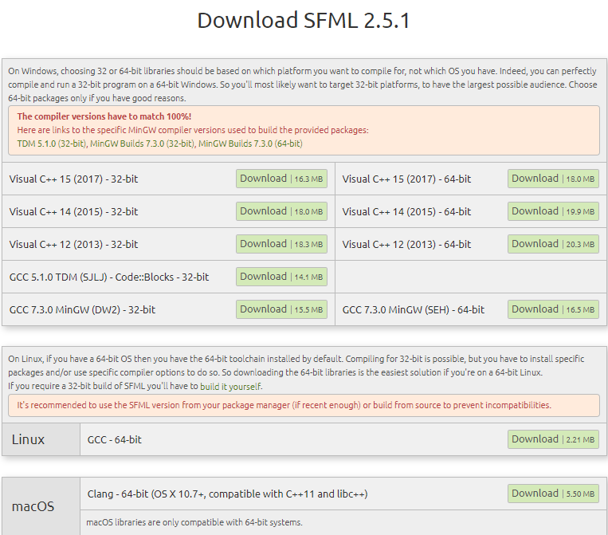
If you’re lucky, the developers have a variety of downloads to match your preferred toolchain
Or at the very least, SOME toolchain…

Slide 16
API – Application Programming Interface
Just like C++ has the std library – you can #include <vector> or <string> in whatever file you want to access that functionality
You #include the relevant header to let the compiler know about a function…
…while the .lib file contains the definition for the linker
The structure of the code you have access to is its API
What header files do you need to #include?
These define what is in those libraries you referenced
(Surprise! Header files aren’t just for irritating students!)
What namespaces are in those headers?
What classes/functions are in those namespaces? That’s what the library can DO
Not all APIs are created equally… some are easy to use and understand, have good documentation
Others? Not so much
The rules are still the same. Adding a library file or two into the mix doesn’t change the basics

Slide 17
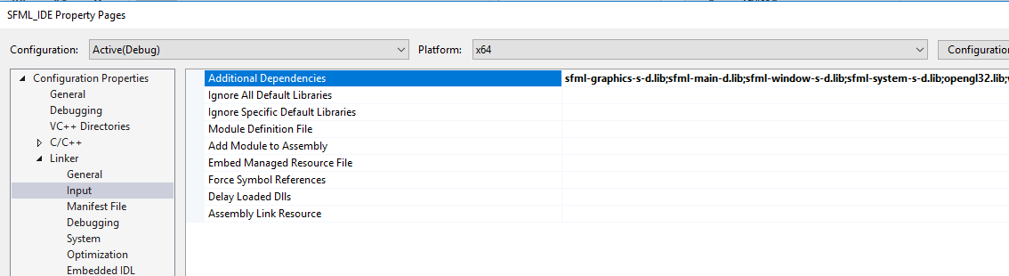
Linking with your IDE
Your IDE will have settings to indicate libraries your project needs
Where those libraries can be found
And a ton of other settings you may or may not care about
Until your project is broken without one of those settings
Indicate these libraries should be used when the project is built

Slide 18
A necessary evil
The initial set up of a project, or a tool chain, is nearly always a pain
THIS IS UNAVOIDABLE
You CANNOT run away from this
Sometimes you get to use tools that “just work” and it’s a wonderful, glorious thing!
For all those other times… you have to live with it, and just deal
Download yet another update, another driver, install another version of another library that the initial library depends on
You will get more comfortable navigating this space as you do it more frequently
Every new tool has a new set of quirks to sort out

Slide 19
How do you KNOW you’re doing it right?
Everything compiles?
Your project actually runs?
Until you DO IT (and possibly fall flat on your face), you don’t know
Read the documentation
Read it. Carefully. No, really.

Slide 20
What about command-line compiling?
Can you link to libraries and build projects from the command line?
Of course! However…
It may be a lot more difficult
Depending on the library
All of your IDE options can be replicated in a makefile
(Behind the scenes, your IDE is using some sort of “make” process anyway)
There may be a LOT of settings, though…
Depending on the complexity of what you’re working with, IDEs may be the preferred path
The alternative may be a lot of headache and frustration…
Far more than the headache of downloading a compiler (which isn’t all that bad, really)

Slide 21
Recap
Libraries are just code written by someone else and made available to you
Linking to them can be simple, or a complex multi-step process that can take a long time to complete
This process is unavoidable, and while you may get better at it over time, every library has its own set of steps
Once you have everything connected, the next step is actually learning how to use it (which is its own thing entirely)

